Slide 1

HOUSING PRICE INDEX ANALYSIS
Group 8:

Slide 2

BACKGROUND
Housing Price Index is is a measure of the average change in price of residential real estate. Meaning, it allows us to document the fluctuations or trends in price over time for specific regions. This project aims to to analyze how the housing market is going to evolve in different Canadian cities. The data was collected and organized to include housing indexes from 2018 - 2023. Machine learning shall be used to gain insight on future trends in the housing market.

Slide 3

GUIDING QUESTIONS
Main Research Question:
How can we use machine learning to predict housing prices, based on historical data?
Supporting Questions:
How have housing prices changed from 2018-2023?
How do major Canadian cities compare in terms of housing prices?
What cities have seen the most dramatic changes?

Slide 4

PROGRAMS / TECHNIQUES USED
Machine Learning Algorithm - Long Short Term Memory Neural Network
Tableau
Pandas
Matplotlib
Google Collab

Slide 5
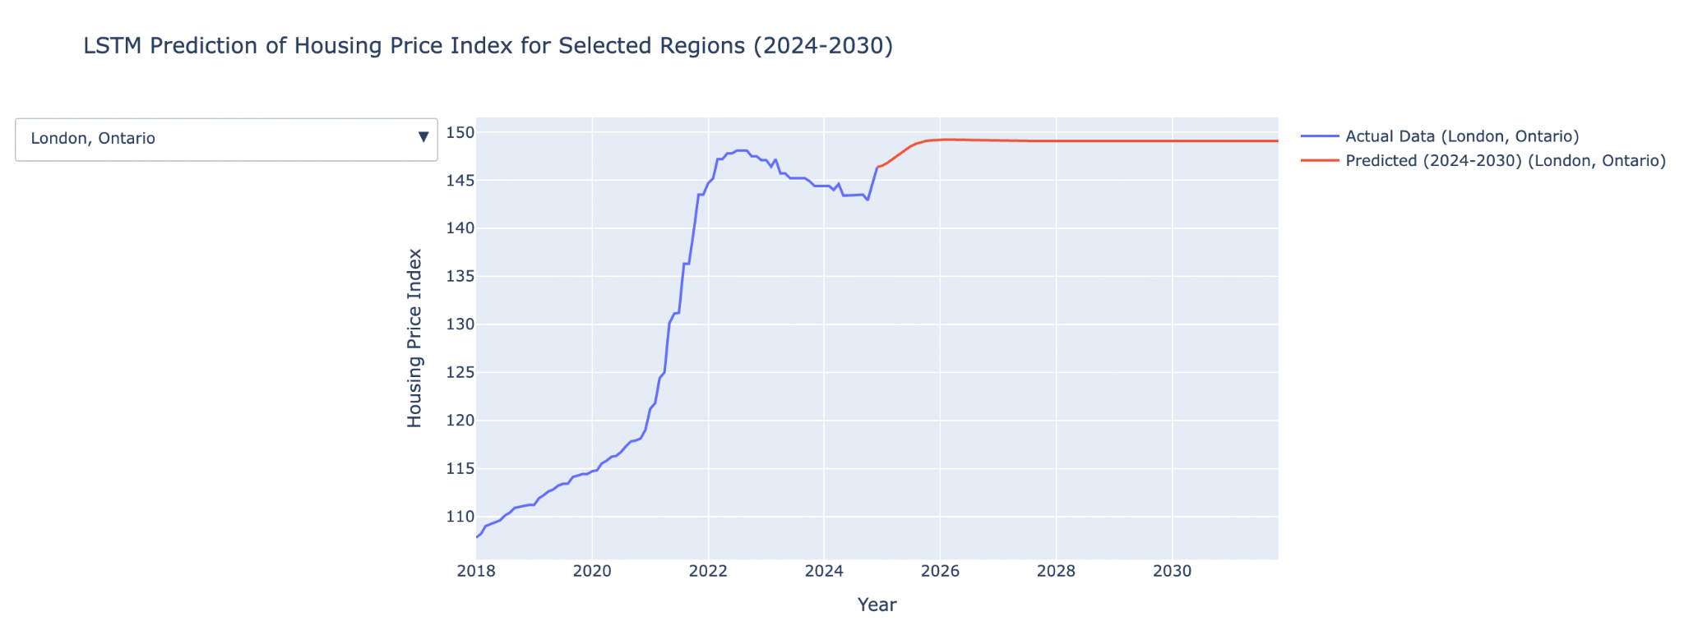
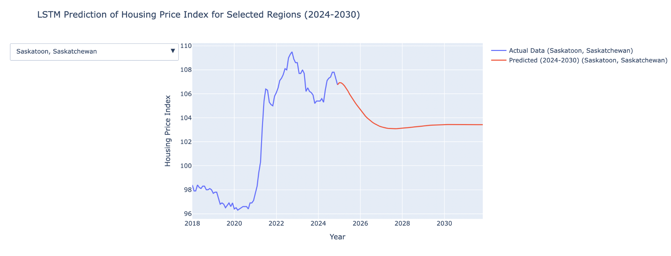
VISUALIZATIONS

Slide 6
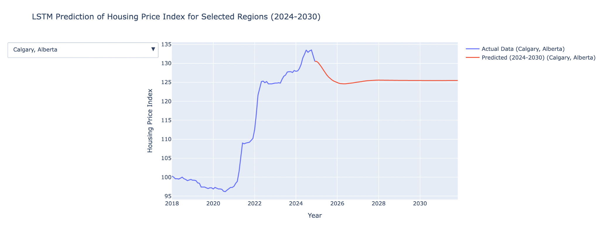
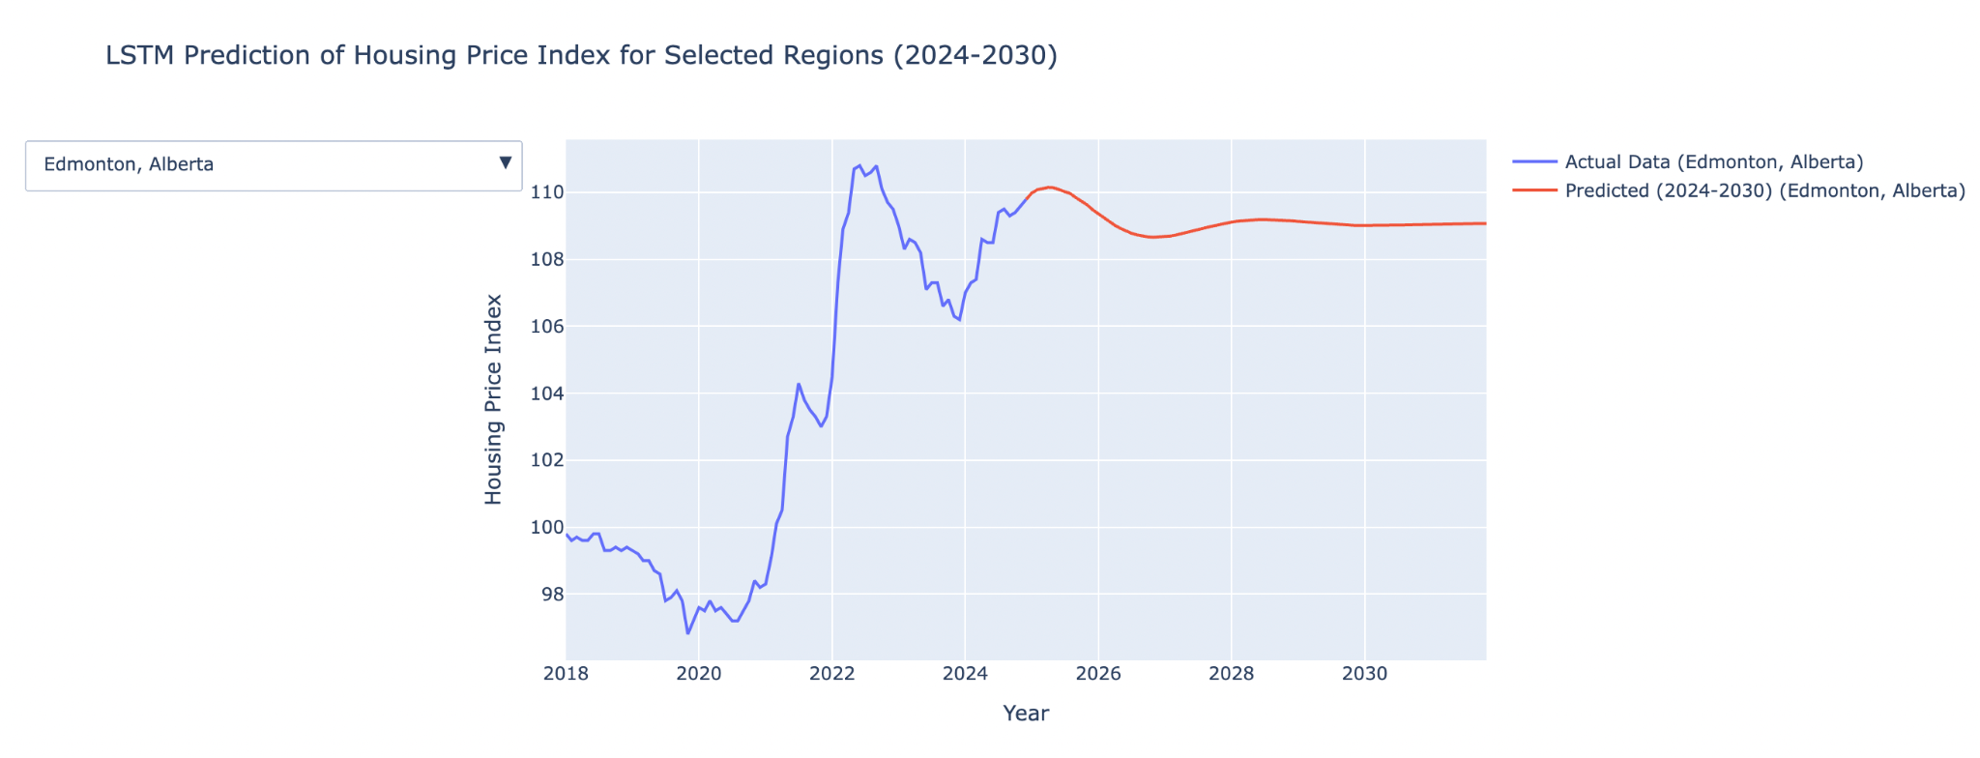

Slide 7
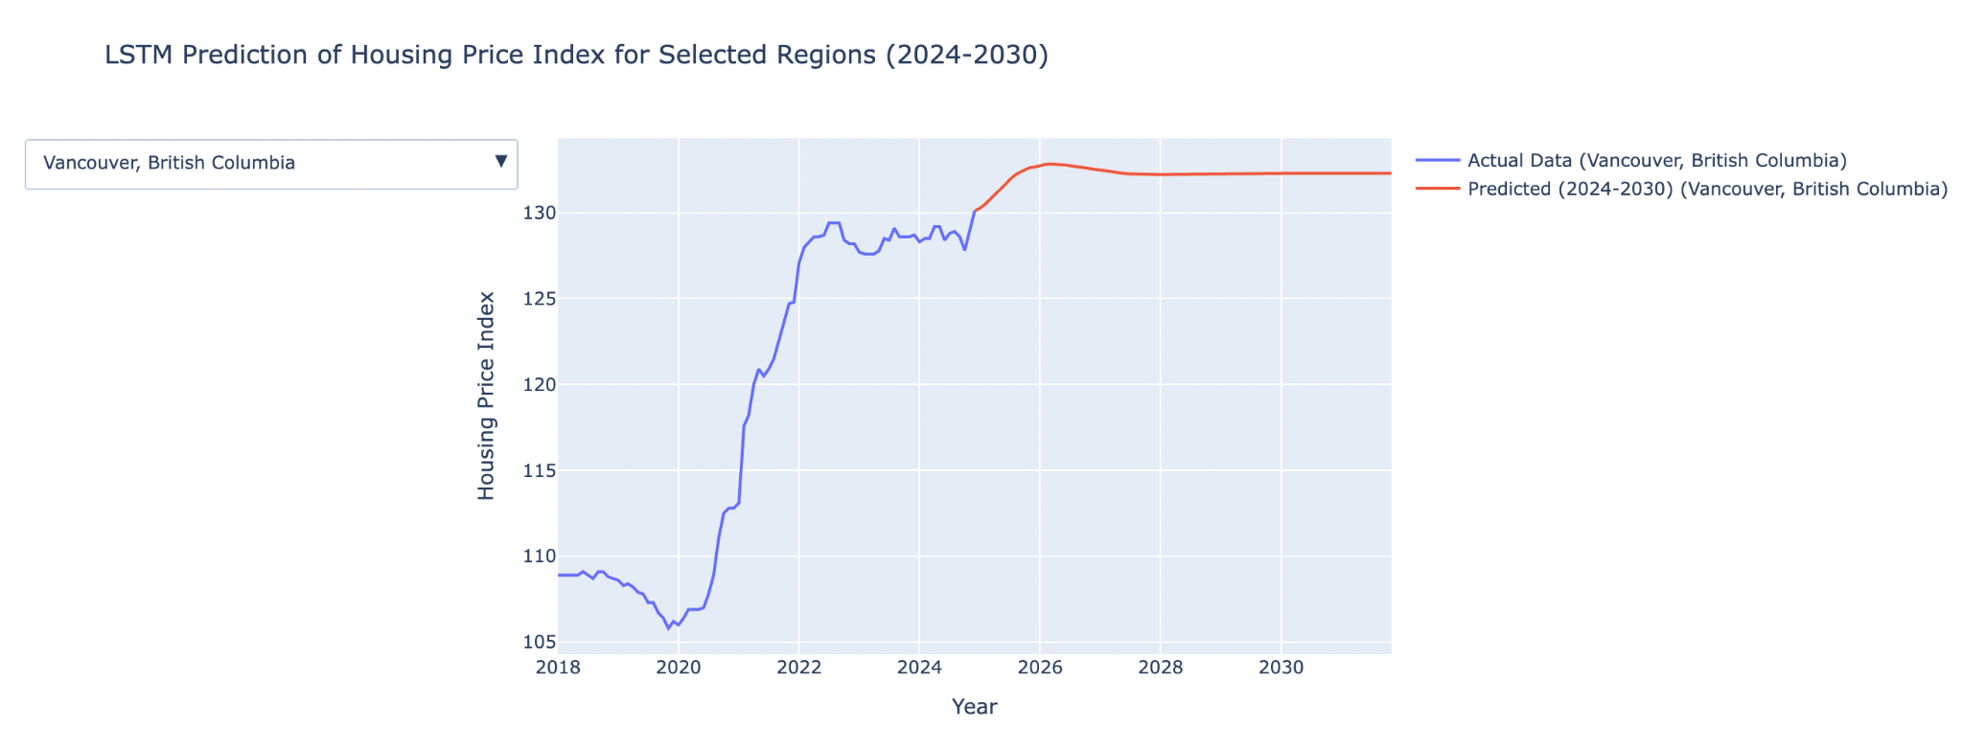
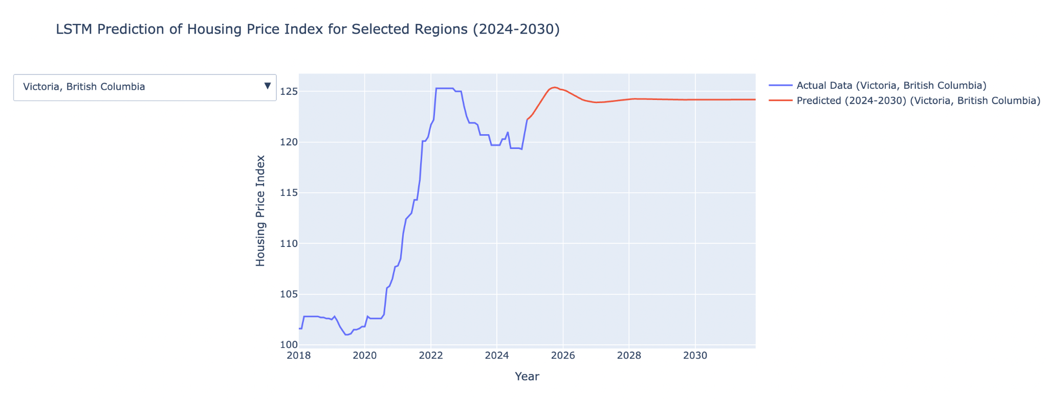

Slide 8
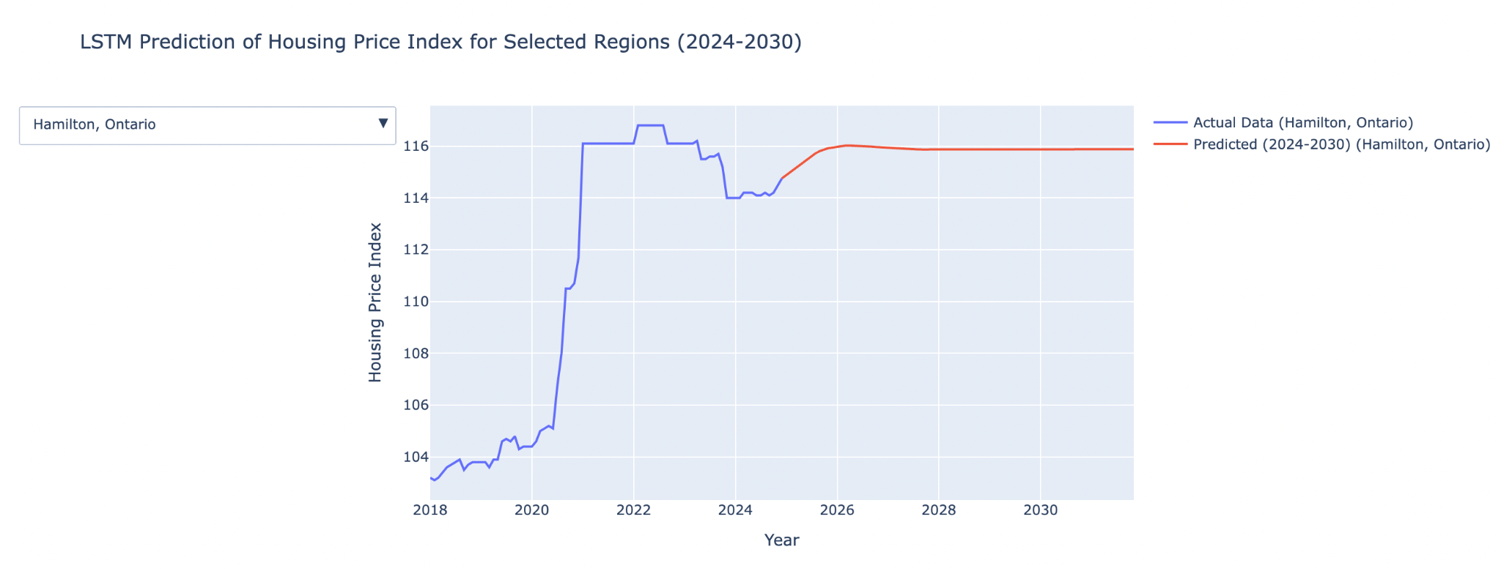
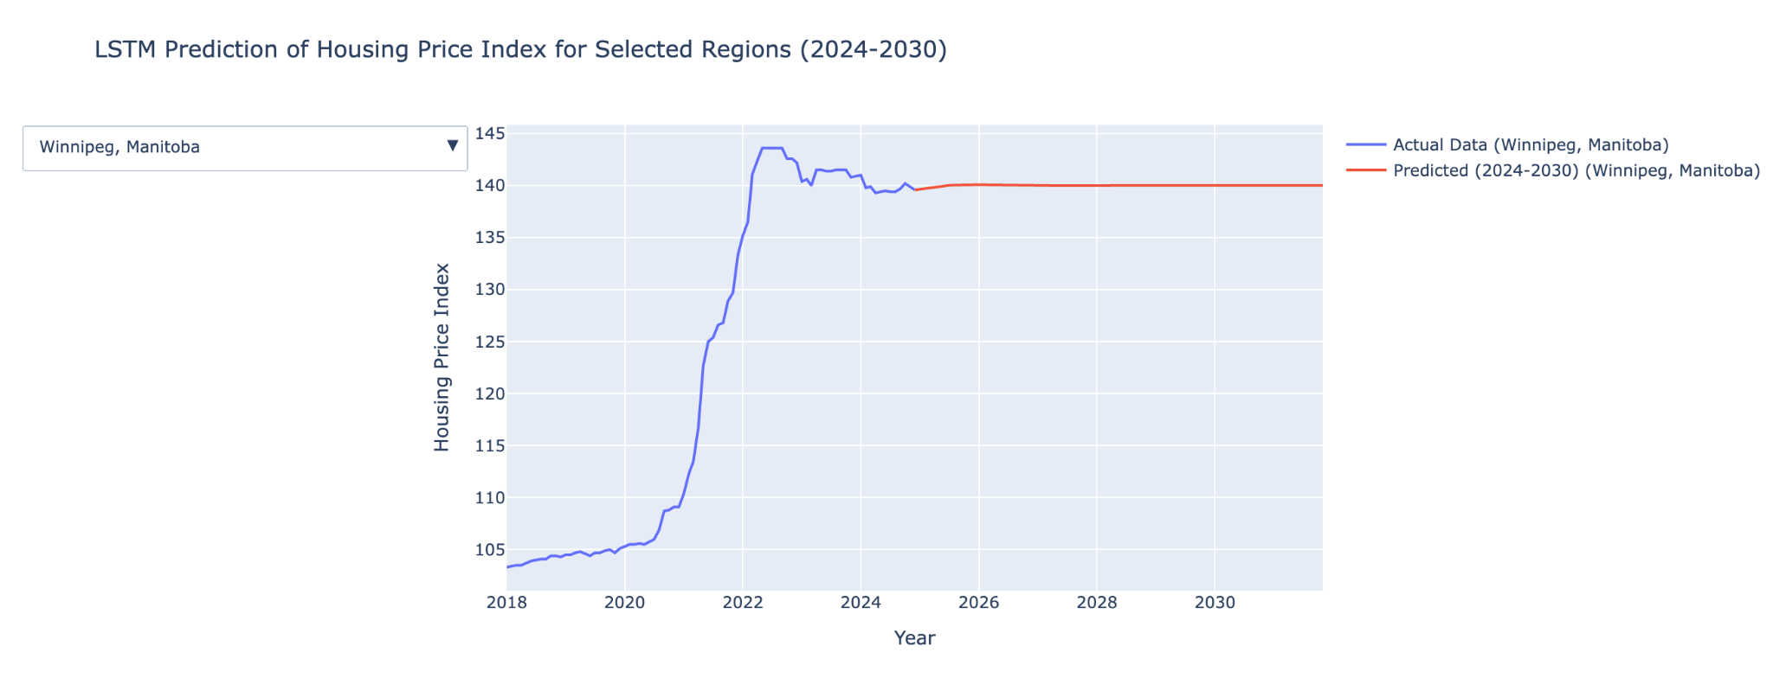

Slide 9
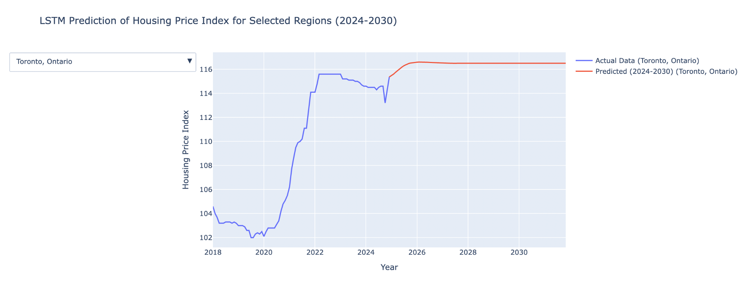
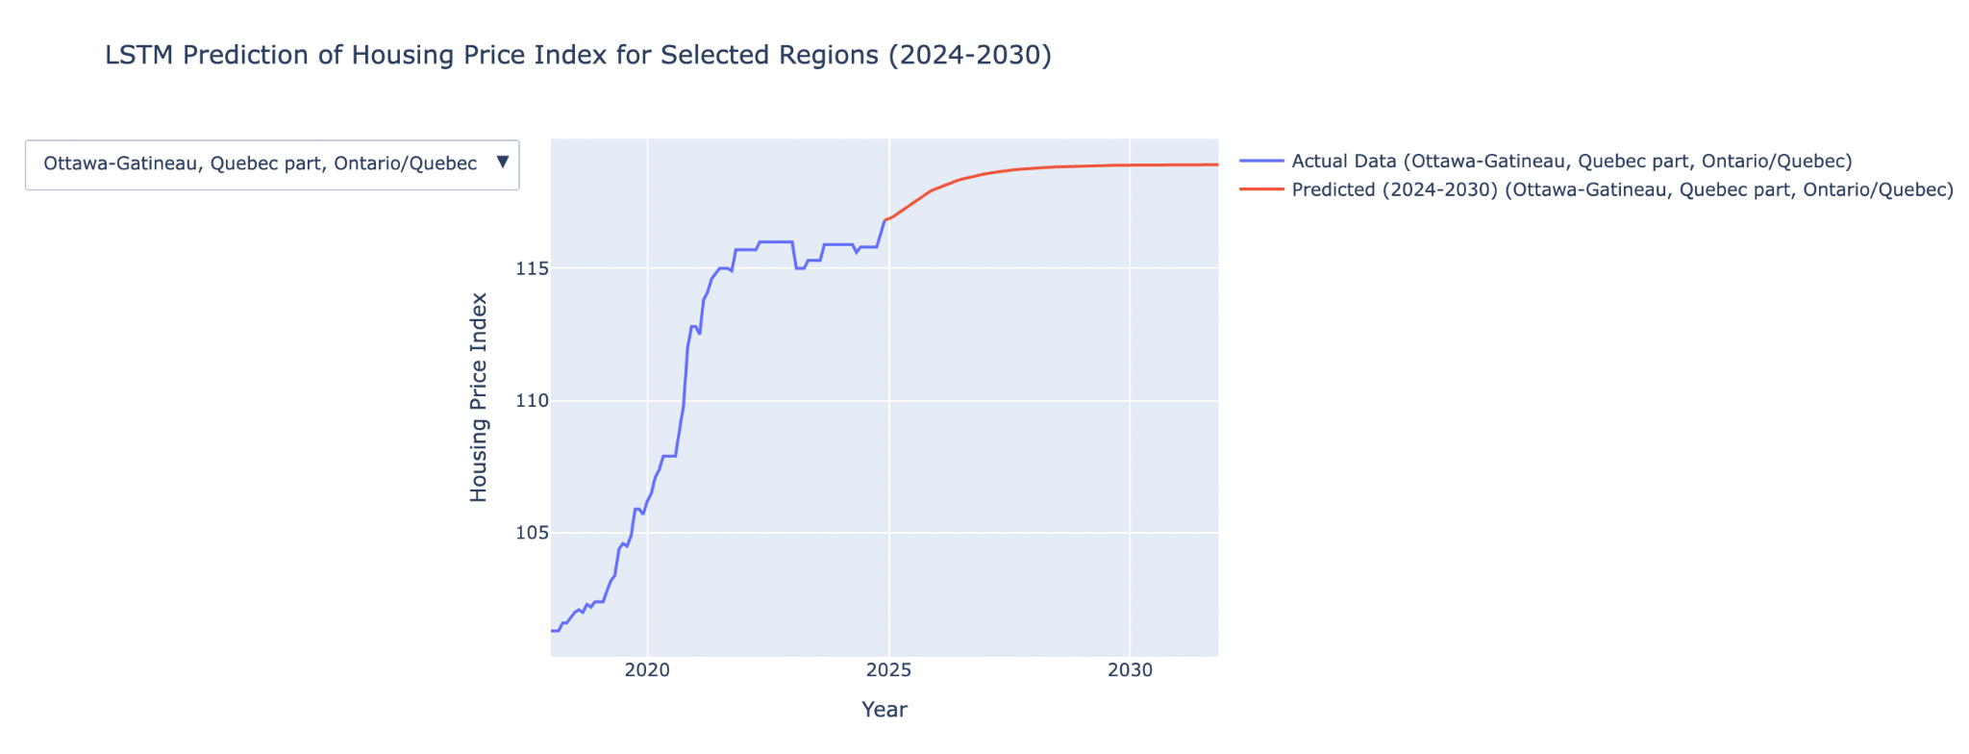
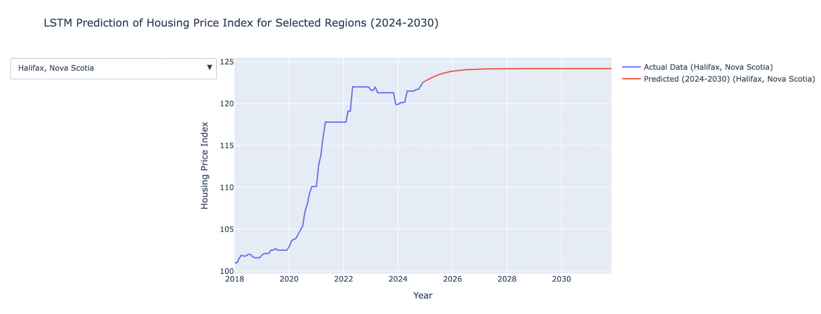

Slide 10

DISCUSSION
-Prices have clearly increased from 2018-2023.
-Predictions show that there are decreases in index values: Calgary, Alberta; Edmonton, Alberta; Saskatoon, Saskatchewan.

Slide 11

POTENTIAL LIMITATIONS
-Other factors affect index prices such as local policy, demand (etc.).
-Machine learning algorithms cannot predict with absolute certainty.

